Slide 1

sign language recognition
Using
template matching technique
Gandhi Institute of Engineering and Technology
Department of Computer Science and Engineering
Mini Project
on
By
Charitha Vadamala - 221710307014
Gopi Bollineni - 221710307029
S Supraja Rao - 221710307055
Vemulapalli Rishitha - 221710307062
Under the guidance
Of
Ms. K. Param Joshi

Slide 2
ABSTRACT
There are a lot of barriers in communication between the deaf, dumb, hard-of-hearing people and the people who can talk and hear. Despite the concern of various groups and activists the teaching of sign language has not been implemented in all of the educational institutions. To overcome these barriers, Sign Language has emerged. Sign Languages are not only much expressive but also convey much more meaning than traditional languages. This makes it really important for everyone to learn and understand sign language.
However, normal individuals cannot fully comprehend these sign languages and various patterns consisting in them. This calls in for a mechanism which can help anyone to understand and implement Sign Languages. This project aims at solving this exact problem through OpenCV-Python, Machine Learning, Image Processing and various pattern and edge detection algorithms. In order to achieve this, initially, an image is captured through a camera, this image is then processed using various algorithms and then edge detection is done using an edge detection algorithm.
Finally, a template matching algorithm identifies the sign and displays the corresponding text. This enables the user to interpret the symbols being presented by another person in real-time and successfully prevails over the barriers of communication with the deaf.

Slide 3
Table of contents:
Introduction
Data Description
Sequence of operations
Gesture Image
Pre-Processing
Feature Extraction
Template Matching
Results
Conclusion

Slide 4
Introduction
In recent years, technologies like gesture recognition, facial recognition have received huge importance under the branch of sign language. Gestures are various movements used in the process of communication. Sign language makes use of gestures, which usually make use of visually transmitted patterns. All over the world, the people suffering from hearing problems have a count of 4,94,93,50,000 approximately. Some of the existing sign language conversion systems consider hand orientation, hand shape and hand movement. In sign language, every sign has a meaning assigned to it, so that it becomes easy to understand and interpret by the people. The people, based on their language and the place in which they live, develop discrete and non-identical sign languages. There is no sign language accepted universally. People use various sign languages across the world.
The proposed work focuses on hand shape and orientation and works on American Sign Language. When using ASL, only one hand is used. Therefore, it becomes easy to implement the system. ASL does not depend on any of the spoken languages and it has its own path of development.
The process in brief includes acquiring images using a camera. Then performing pre-processing steps on the image, that is, convert the acquired image, which is in the RGB model to gray scale image. Later, track the edges by using a canny edge detection algorithm. Finally, detecting the pattern using template-matching algorithm, this outputs the result as text.This system bridges the imbalances between deaf people and normal people without any requirement of an intermediate translator.

Slide 5
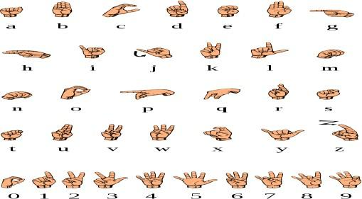
Data Description
The proposed system uses American Sign Language (ASL) data set to identify the sign made by a gesture. The data set has numbers labeled from zero to nine and alphabets from a to z. This data set has 70 samples for each of the 36 symbols. There are 70 samples for each symbol. These 70 samples of each symbol cover all the hand shapes and movements. The features are all of the right hand. The entire data set is available in both compressed and uncompressed format. Every sample of the data set is characterized with its equivalent sign. A unique sign letter corresponds to every sample.
American Sign Language(ASL):
It originated two centuries ago. It has many features that are similar to the languages people speak. It is different from the English that people use for communication daily. The semantics of ASL also deviates from that of English. ASL makes use of gestures of the hand. They also include facial gestures. ASL consists of 26 symbols,known as American manual alphabet. They are in Fig 1. ASL contains vowels and consonants.

Slide 6
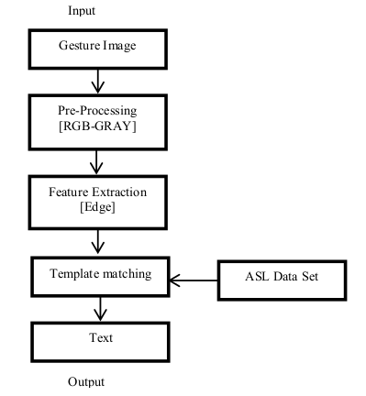
Sequence of operations
The following diagram represents the schematic sequence of operations that will be performed in this study:

Slide 7
Gesture Image:
The hand gestures of the person are acquired using any kind of camera.
Though, the camera mounted to the laptop is used in this study.
The image of the hand gesture is captured in Red-Green-Blue(RGB) format.
In order to get rid of distortions caused by light and shadows we can normalize the RGB values.The normalization process proceeds using the following three equations (1), (2), (3). The sum of the normalized components of RGB is unity (r + g + b = 1).

Slide 8
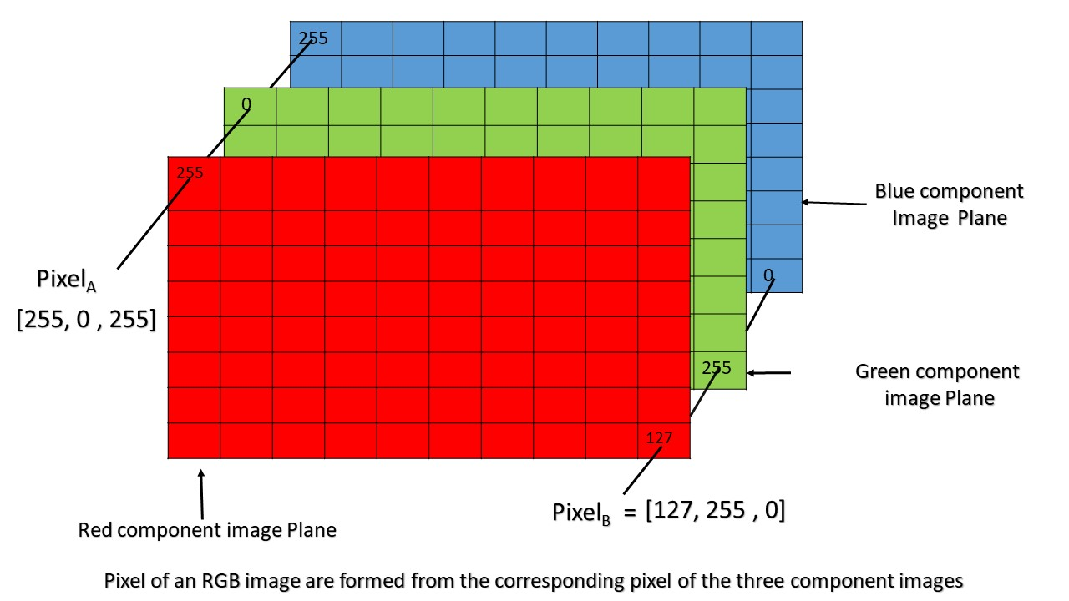
Pre-Processing:
In this step, transformation of RGB image takes place, which is 3D to 1D. This transformation to one-dimensional image is to ease the process. The one-dimensional format is the gray scale image. There are various methods to convert an image from RGB color space to gray image. Here, Average method is used. Average method is the most basic and simple method that is used for converting image to grayscale image. It works as shown in (4),
Gray=(R+G+B)/3 ------> (4)
This method takes 33% of RED, 33% of GREEN and 33% of BLUE i.e. the contribution is equal from all the three colors. This method does not turn out to be the best, but for this work, this method works well and satisfies the requirement.

Slide 9
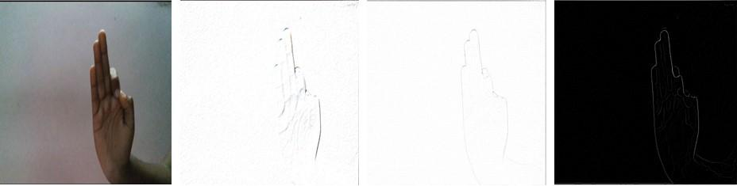
Feature Extraction:
In image analysis, determining the edges is important. Edge detection is useful to extract boundaries, corners, lines and curves. It removes the data that is not useful. Canny edge detection algorithm works better than many other edge detection algorithms. The figure below shows output of various edge detection algorithms.
Fig. 3. Input image (RGB format)
Fig. 4. Roberts cross edge detection
Fig. 5. Laplacian edge detection
Fig. 6. Canny edge detection
Fig.3. Fig.4. Fig.5. Fig.6.
Canny Edge Detection:
Canny edge detection algorithm has multiple stages. Precisely, there are five stages to detect the edges using this algorithm.
Image Smoothening
Gradient Magnitude
Non-maximum Suppression
Double Threshold
Hysteresis

Slide 10
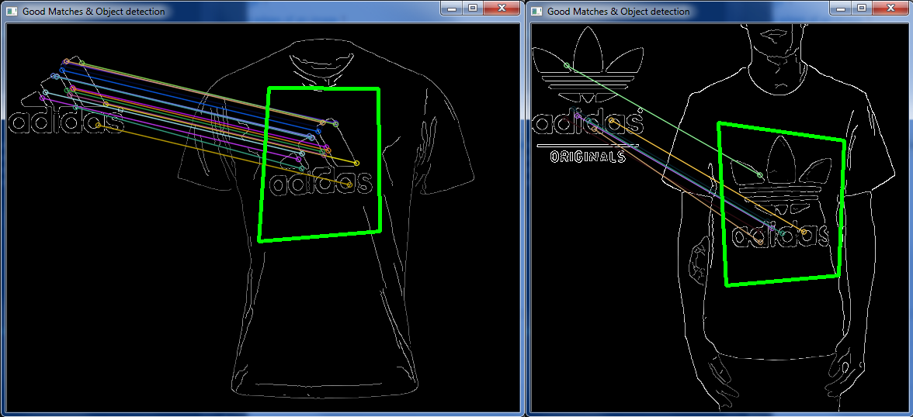
Template MAtching:
After processing the image through various stages, the image obtained is, compared with the images in the data set. By using a template-matching algorithm, identification of the pattern is possible. Here, the template image is the edge image obtained from edge tracking. The dimensions of the template image are m x n. The dimensions of the image in the data set are m x n. This comparison of template images with the images present in the data set uses the Sum of Absolute Difference (SAD) method. SAD method computes intensity values. This method computes the values by subtracting the pixel values of both the images and then adds the result, until no pixel is left. The image that produces the least SAD value indicates the best match for a sign and its corresponding label is the output.

Slide 11
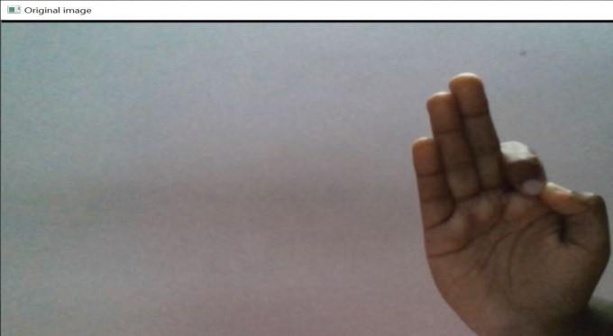
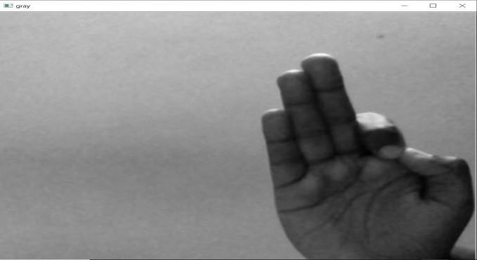
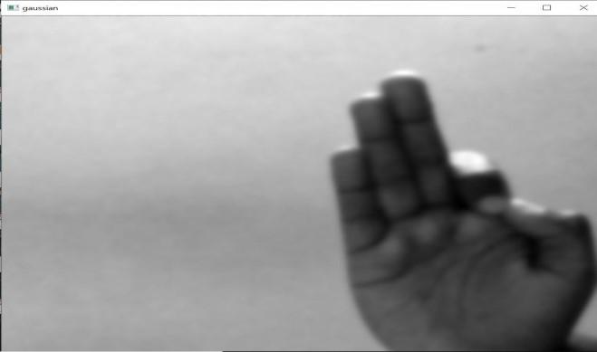
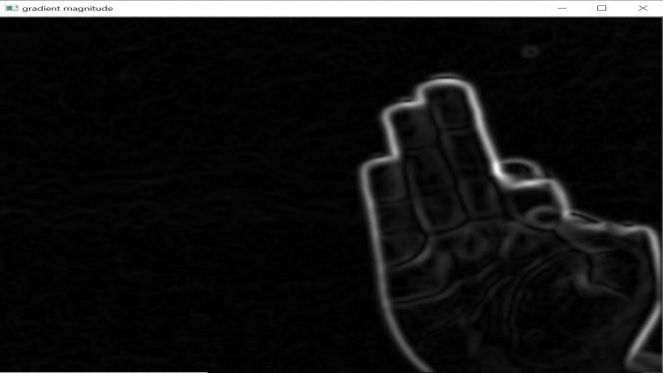
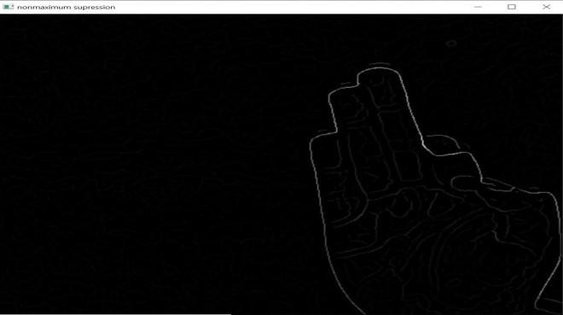
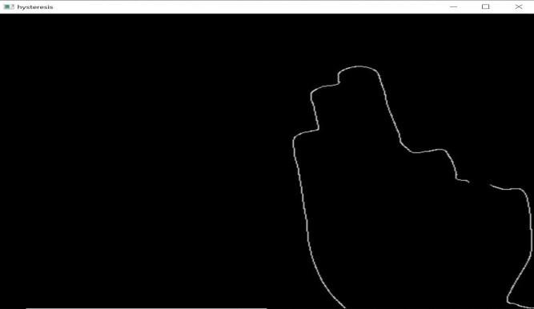
Results[Expected]
Image captured in RGB.
Image converted to Grayscale
Image after applying Gaussian filter for smoothing.
Gradient Magnitude Image
Image after non maximum suppression.
Hysteresis Image

Slide 12
Software REquirements:
Operating System: Windows/Linux/Mac
Programming Language: Python
Native Applications: Tkinter(Python)
IDE/Workbench: Visual Studio Code/Jupyter

Slide 13
Hardware Requirements:
Processor: Intel Core i5/i7/i9
Space: 10GB[including dataset]
RAM: 8GB/GPU:4GB(optional)

Slide 14
CONCLUSION
The aim of this study is to help and serve the differently-abled persons in the world with difficulty in hearing and are deaf by providing them with a technology that can aid them to communicate to others using the American Sign Language. In future, we can develop a system that is two-way system where, conversion of sign to text and text to sign is possible. Developing a system, where interpretation involves dynamic gestures. Implementation can extend to mobile phones.

Slide 15
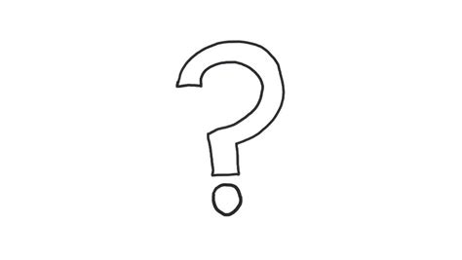
Any Queries?

Slide 16

THANK YOU!

